Slide 1
Project 4: Machine Learning model & visualizations
Group5: Patrick Yau & Sharanjit Singh

Slide 2
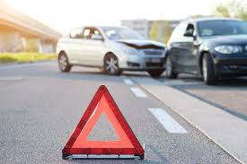
Background
Project topic: Can we predict the severity of road accidents in the UK based upon 2021 data based on environmental and situational features (like weather, road conditions, and time)?
To build machine learning model and visualize them using various interactive data visualization techniques.
Dataset: Taken data from Kaggle with 300k rows, reduced to 100k rows and 23 columns
CSV data converted to SQL and then uploaded using SQL Alchemy
Aims:
Predicting accident severity based on weather, road conditions, and vehicle type.
Identifying high-risk areas where accidents frequently occur.
Analyzing patterns in accidents related to time of day, road type, and urban vs. rural locations.

Slide 3
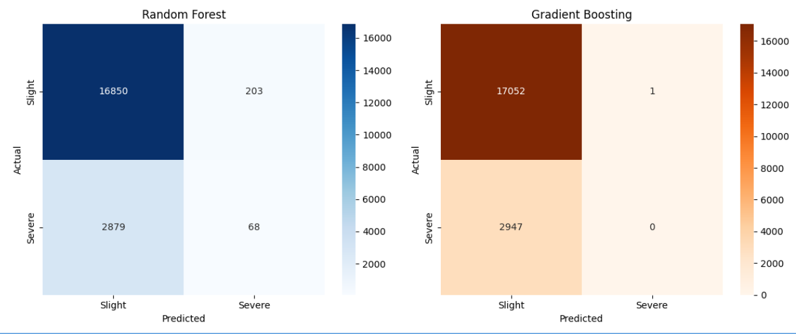
1. Predicting Accident Severity Model: ML Type: Classification Models: Scikit-learn (Random Forest, Gradient Boosting, XGBoost & SVM) Features: Weather Conditions, Road Surface Conditions, Light Conditions, Time, Speed limit, 'Urban or Rural Area, Vehicle Type Target variable: Accident Severity
Key Takeaways
Random Forest slightly struggles with false negatives but still detects some Severe accidents correctly.
Gradient Boosting almost never predicts Severe accidents correctly, leading to high false negatives (Severe misclassified as Slight).
If Severe accident detection is important, Random Forest might be the better choice, but if Slight accident classification is the priority, Gradient Boosting performs better.

Slide 4
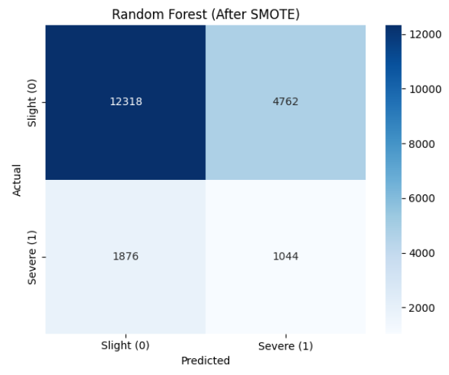
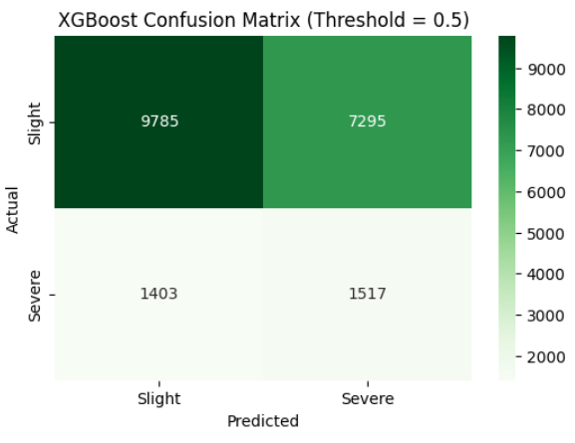
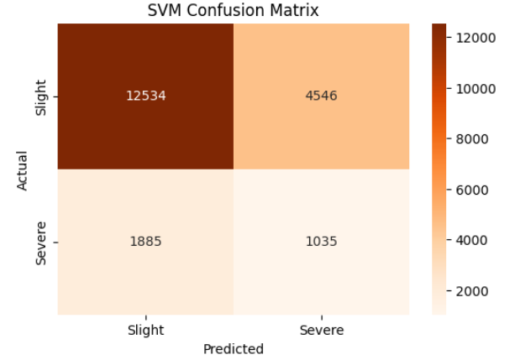
Improvement to model:
Balance Classes: Since the model is struggling with Severe accidents, it may be biased toward Slight accidents (class imbalance). Using SMOTE (Synthetic Minority Over-sampling Technique):
This will increase Serious/Fatal cases synthetically and improve classification
Using another model XGBoost as it works well on imbalanced data

Slide 5
Comparison result between different models
Metric | Random Forest | XGBoost | SVM | Key Insights
Accuracy | 67% | 57% | 68% | SVM slightly outperforms Random Forest; XGBoost lags behind.
Precision (Slight) | 0.87 | 0.87 | 0.87 | All models classify "Slight" cases with high precision.
Recall (Slight) | 0.72 | 0.57 | 0.73 | SVM has the best recall for "Slight" cases; XGBoost struggles.
F1-score (Slight) | 0.79 | 0.69 | 0.8 | SVM performs best for "Slight" case balance.
Precision (Severe) | 0.18 | 0.17 | 0.19 | All models struggle to correctly classify "Severe" cases.
Recall (Severe) | 0.36 | 0.52 | 0.35 | XGBoost captures more "Severe" cases, but at a cost of accuracy.
F1-score (Severe) | 0.24 | 0.26 | 0.24 | XGBoost has the best balance for "Severe" cases, but all models need improvement.
Weighted F1-score | 0.71 | 0.63 | 0.72 | SVM slightly outperforms Random Forest; XGBoost is less balanced.
If overall balanced classification is needed, Random Forest is best bet.
If capturing more Severe cases is the goal, XGBoost performs better, but at the cost of accuracy.
If prioritizing correct Slight case predictions, SVM delivers the highest recall and F1-score for that class.

Slide 6
Conclusion: Best Overall Model
| ✅ XGBoost is the best overall model as our priority is detecting severe accidents (highest recall). It trades a few more false positives (slight misclassified as severe) to catch more actual severe accidents, which is often a worthwhile tradeoff in safety-critical scenarios.

Slide 7
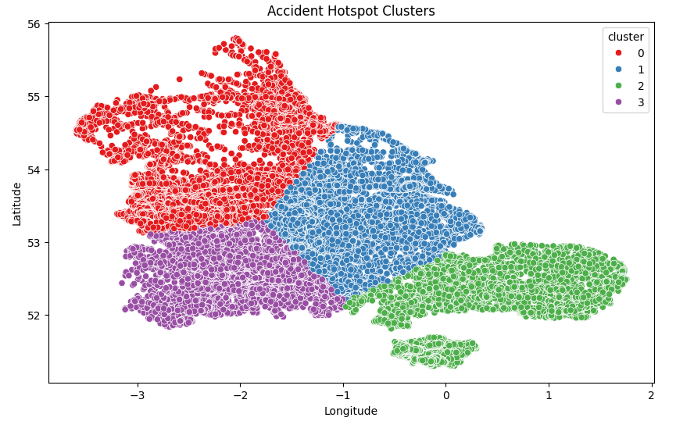
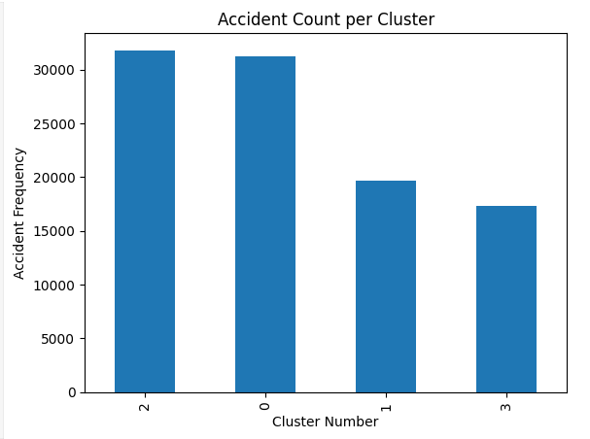
2) Identify High-Risk Accident Zones A) Using K-means with 4 clusters
Accident Hotspot Clusters scatter plot provides valuable insights into high-risk zones where accidents frequently occur
Interpretation of the Clusters
✔ Cluster 0 (Red) → This region has high accident density, likely indicating urban congestion, busy intersections, or poor visibility. ✔ Cluster 1 (Blue) → These accidents may be spread across major roads or highways, suggesting speed-related or lane-merging risks. ✔ Cluster 2 (Green) → This cluster might show localized accident hotspots, possibly near residential or commercial areas. ✔ Cluster 3 (Purple) → Typically found in less densely populated regions, meaning accidents here may be influenced by weather conditions or rural road designs.

Slide 8
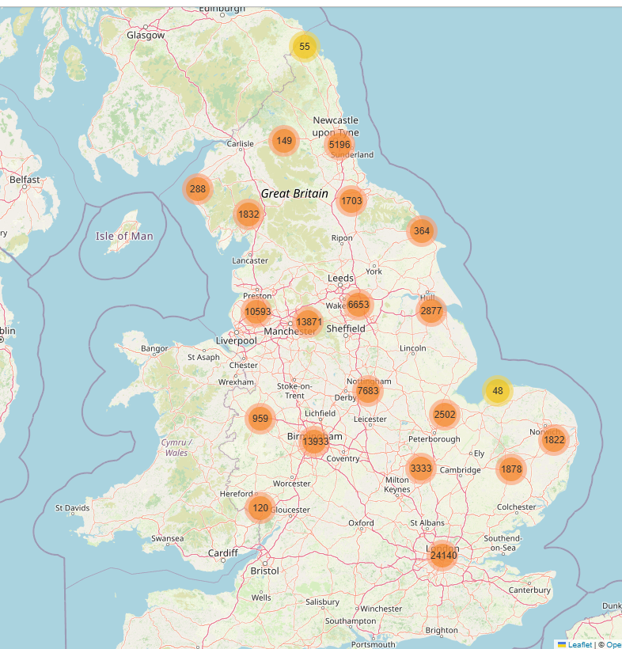
2 (B) Unsupervised learning: Identify High-Risk Accident Zones ML Type: Clustering Models: DBSCAN
Feature Selection
- Used Latitude & Longitude for spatial clustering
- Severity-Based Marker Representation
Color-coded markers differentiate between accident severity:
Red: High-risk severe accidents.
Green: Slight accidents.
This allows easy identification of hazardous areas
Result: What This Signifies:
Identifying High-Risk Zones: The clusters highlight areas with frequent accidents, helping pinpoint locations needing better safety measures.
Traffic & Urban Planning Insights: This can assist city planners in making informed decisions about road improvements, traffic regulations, or infrastructure changes.
Accident Pattern Analysis: By examining severity, time of day, and other factors within clusters, authorities can implement targeted interventions for accident prevention.
* Shows overall London is more accident prone

Slide 9
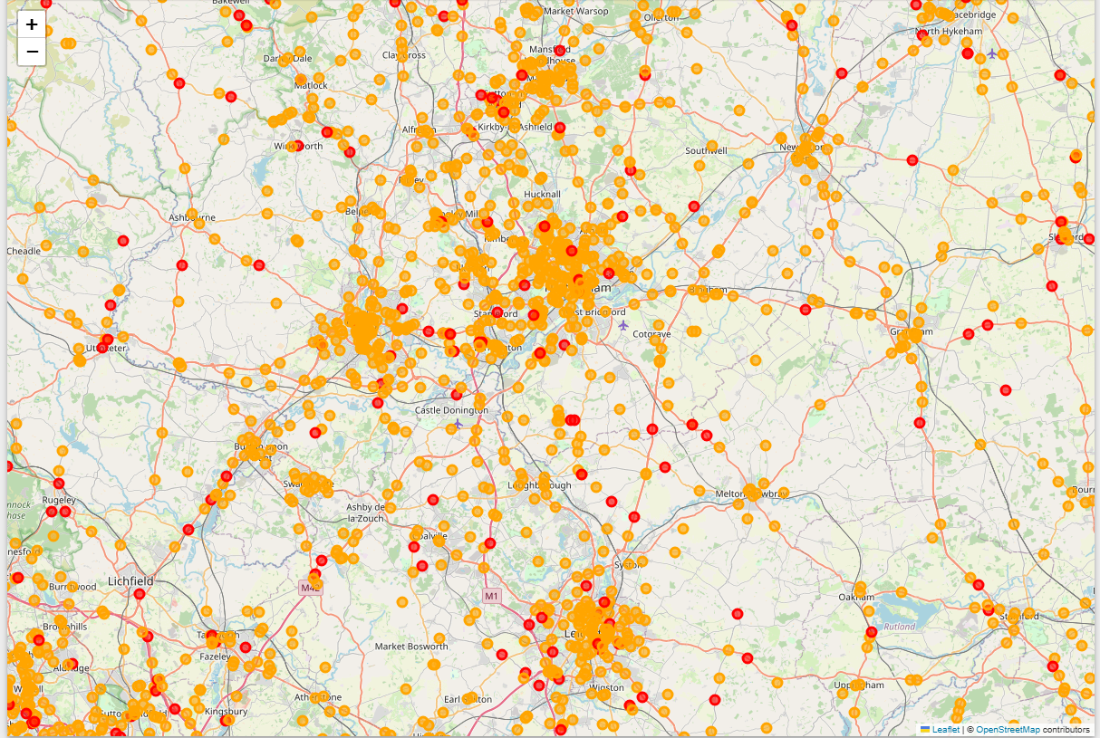
2 (C) Unsupervised learning Overlaying Accident Severity onto the cluster map will help prioritize high-risk zones
Key Observations:
DBSCAN, which detects clusters based on density
Extracts relevant accident data (latitude, longitude, severity).
🚦 Dense Clustered Zones & Severity-Based Mapping:
Fatal accident clusters are marked in red, emphasizing high-risk areas.
Serious accident zones (orange) show potential danger hotspots needing intervention.
🚦 Strategic Safety Insights:
High-risk urban areas likely require traffic calming measures, enhanced enforcement, or infrastructure upgrades.
Remote accident sites may benefit from better emergency response planning and road condition improvements.

Slide 10
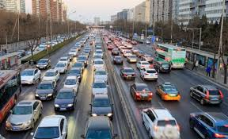

Overall end benefit of analysis
Strategic Road Safety Insights:
Targeted traffic measures (speed limits, enhanced road visibility, and infrastructure upgrades) can significantly reduce accident frequency in identified high-risk areas.
Predictive analytics can improve prevention efforts, using accident history and real-time traffic data to forecast future high-risk conditions.
Integration of severity-based heatmaps and policy recommendations will further enhance public safety and emergency response efficiency

